Slide 1
Discrete Mathematics
South China University of Technology
1

Slide 2
Chapter 10. Trees
Spanning Trees
Section 10.4
2

Slide 3
Contents
1
Introduction
2
Depth-First Search
3
Breadth-First Search
4
Backtracking Application
3

Slide 4
Introduction
4

Slide 5
A Road System
Old Town
Old Town
Etna
Etna
Herman
Herman
Orono
Orono
Bangor
Bangor
Hampden
Hampden
This problem was solved with a connected subgraph with the minimum number of edges containing all vertices of the original simple graph.

Slide 6
Definition 1
Let G be a simple graph. A spanning tree of G is a subgraph of G that is a tree containing every vertex of G.
A simple graph with a spanning tree must be connected, since there is path in the spanning tree between any vertices. The converse is also true, that is, every connected simple graph has a spanning tree.

Slide 7
Example 1 Find a spanning tree
Find a spanning tree of the simple graph G.
a
b
c
d
e
f
g
Edges removed: {a, e} {e, f} {c, g}

Slide 8
Spanning Trees of G
a
b
c
d
a
b
c
d
e
f
g
e
f
g
a
b
c
d
a
b
c
d
e
f
g
e
f
g

Slide 9
Theorem 1
A simple graph is connected if and only if it has a spanning tree.
Proof:
1. spanning tree T ⇒ graph G is connected.
T contains every vertex of G.
Furthermore, there is a path in T between any two of its vertices.
Since T is a subgraph of G, there is a path in G between any two of its vertices. Hence, G is connected.

Slide 10
Proof of Theorem 1
2. graph G is connected ⇒ spanning tree T .
Now suppose that G is connected.
If G is not a tree, it must contain a simple circuit.
Remove an edge from one of these simple circuits.
The resulting subgraph has one fewer edge but still contains all the vertices of G and is connected.
This subgraph is still connected because when two vertices are connected by a path containing the removed edge,
they are connected by a path not containing this edge.

Slide 11
Proof of Theorem 1
We can construct such a path by inserting into the original path,
at the point where the removed edge once was,
the simple circuits with this edge removed.
Repeat this process until no simple circuits remain.
This is possible because there are only a finite number of edges in the graph.

Slide 12
Proof of Theorem 1
The process terminates when no simple circuits remain.
A tree is produced since the graph stays connected as edges are removed.
This tree is spanning tree since it contains every vertex of G.

Slide 13
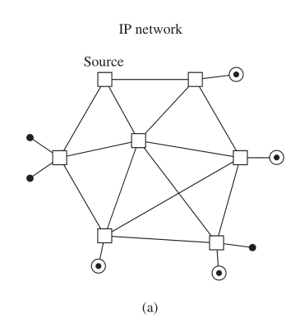
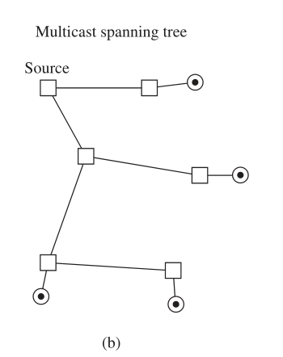
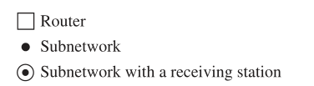
A multicast spanning tree

Slide 14
Depth-First Search
14

Slide 15
finding spanning trees
Idea 1. remove edge from simple circuits.
Idea 2. successively adding edges.

Slide 16
Algorithm : depth-first search.
1. Arbitrarily choose a vertex of the graph as the root.
2. Form a path starting at this vertex by successively adding vertices and edges, where each new edge is incident with the last vertex in the path and a vertex not already in the path.

Slide 17
Algorithm : depth-first search.
3. Continue adding vertices and edges to this path as long as possible.
4. If the path goes through all vertices of the graph, the tree consisting of this path is a spanning tree.
5. If the path does not go through all vertices, more vertices and edges must be added.

Slide 18
Algorithm : depth-first search.
6. Move back to the next to last vertex in the path, and, if possible, form a new path starting at this vertex passing through vertices that were not already visited.
7. If this cannot be done, move back another vertex in the path, that is, two vertices back in the path, and try again.

Slide 19
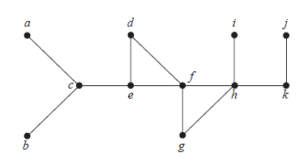
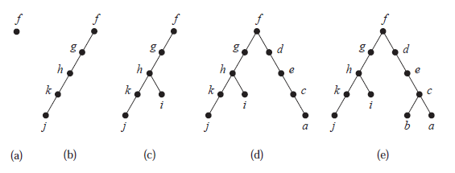

Slide 20
Example 3
The edges selected by a depth-first search of a graph are called tree edges 树边.
The other edges are called back edges 背边.

Slide 21
Example 4
a
d
i
j
f
c
e
k
h
g
b
Back edges : ( e, f ) ( f, h )

Slide 22
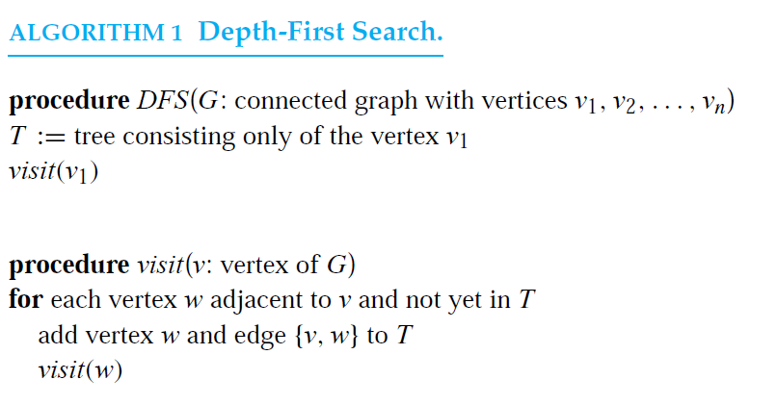
Algorithm 1 : Depth-First Search
O(e) or O(n^2) since e<=n(n-1)/2

Slide 23
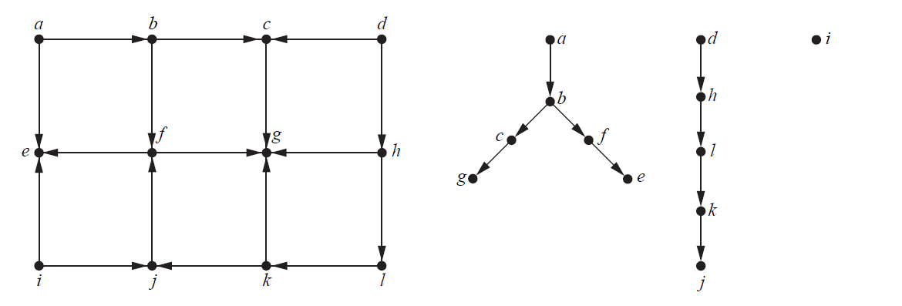

Slide 24
Breadth-First Search
24

Slide 25
Algorithm : breadth-first search.
1. Arbitrarily choose a vertex of the graph as the root.
2. Add edges incident to this vertex. The new vertices added at this stage become the vertices at level 1 in the spanning tree. Arbitrary order them.
3. For each vertex at level 1, visited in order, add each edge incident to this vertex to the tree as long as it does not procedure a simple circuit.

Slide 26
Algorithm : depth-first search.
4. Arbitrarily order the children of each vertex at level 1. This produces the vertices at level 2 in the tree.
5. Follow the same procedure until all the vertices in the tree have been added.
6. The procedure ends since there are only a finite number of edges in the graph.
7. A spanning tree is produced since we have produced a tree containing every vertex of the graph.

Slide 27
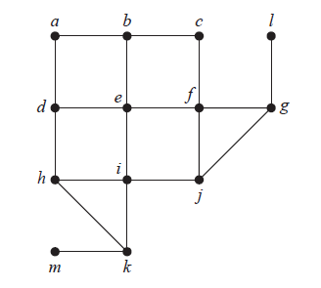
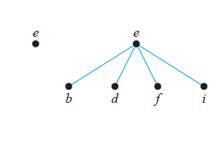

Slide 28
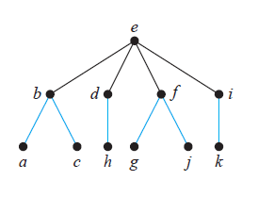

Slide 29
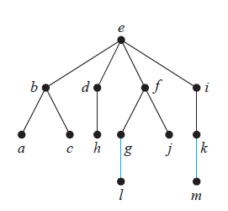

Slide 30
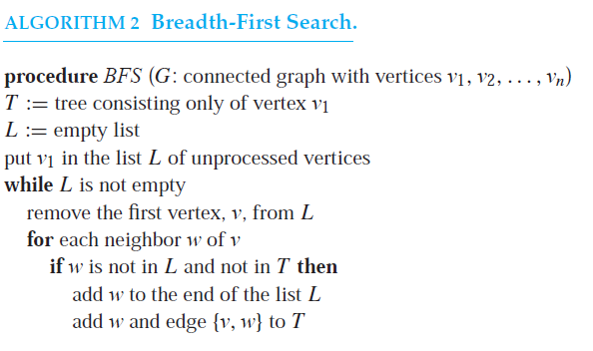
Algorithm 2 : BFS

Slide 31
Backtracking Application
31

Slide 32
Depth-first search is also called backtracking, because the algorithm returns to vertices previously visited to add paths.
Allows for the systematic(exhaustive) search for solutions to a wide variety of problems
Model as a decision tree, where each internal vertex represents a decision and each leaf a possible solution.

Slide 33
Example 6
Graph Coloring : How can backtracking 回溯 be used to decide whether a graph can be colored using n color?
eg, n=3,
3- Coloring is a NPC problem

Slide 34
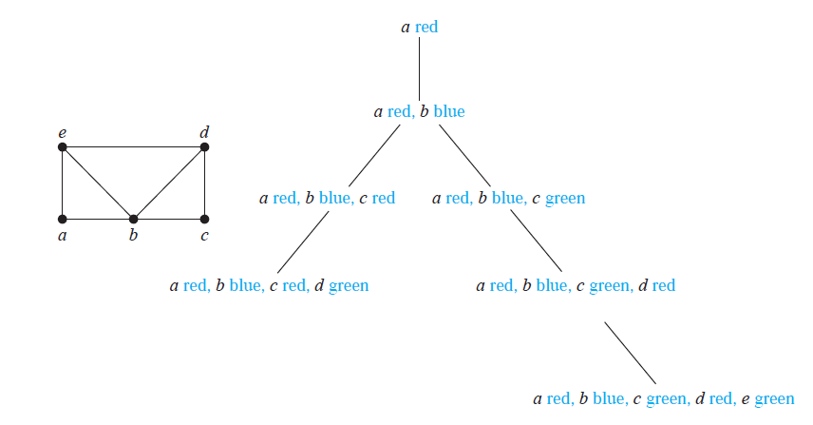

Slide 35
Example 6 Sums of Subsets
Consider this problem. Given
a set of positive integers { x1, x2, . . . , xn },
a positive integer M
find a subset of this set of integers that has M as its sum.
Eg, {10, 7, 3, 1} , M=14
How can backtracking be used to solve this problem?
NPC

Slide 36
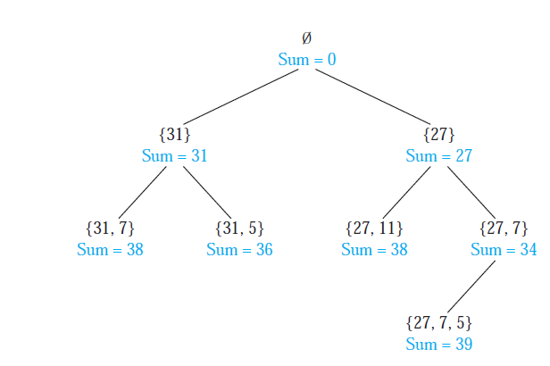
Find a subset of {31, 27, 15, 11, 7, 5} with the sum equal to 39.

Slide 37
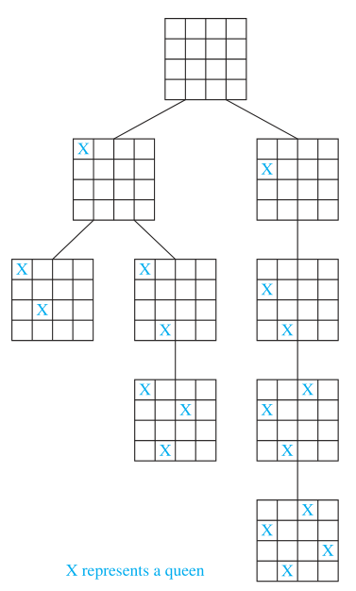
The n-Queens Problem
how n queens can be placed on an n × n chessboard so that no two queens can attack one another. How can backtracking be used to solve the n-queens problem? No two of these positions are in the same row, same column, or in the same diagonal

Slide 38
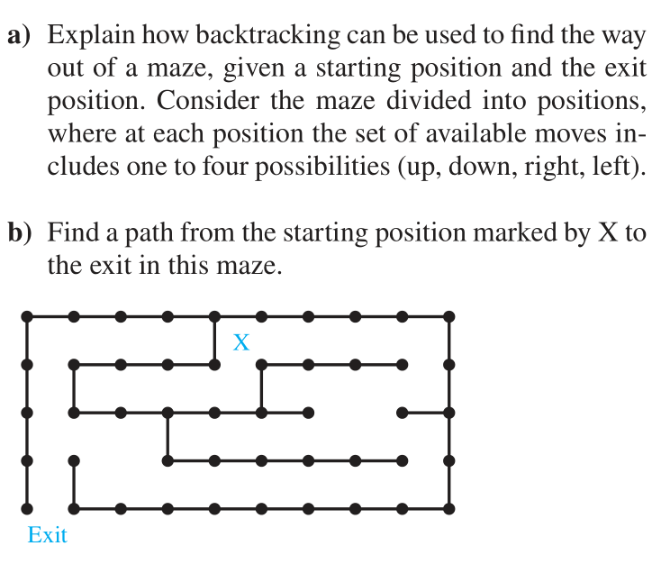
思考题(历史上的类似考题,完整版课后题)

Slide 39
Homework
1
3
9, a)
11

Slide 40
End of Section 10.4
Click to edit company slogan .
40

